Slide 1
Unit - III Graphs
Course Code: 21AI33

Slide 2
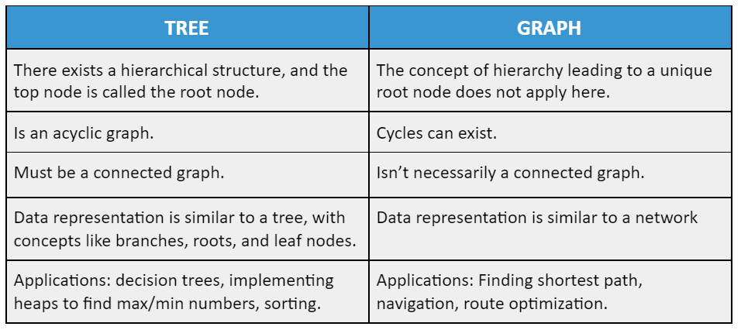
Trees and Graphs

Slide 3
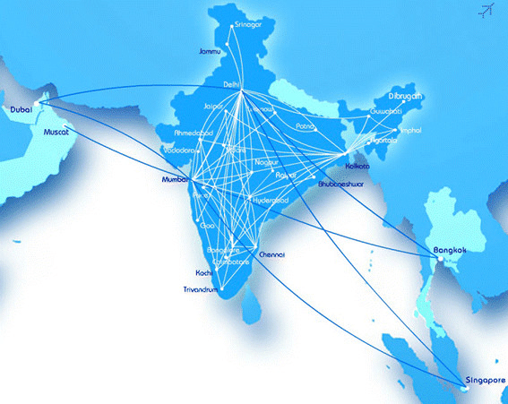
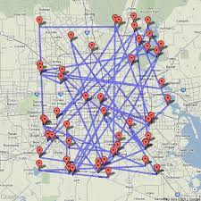
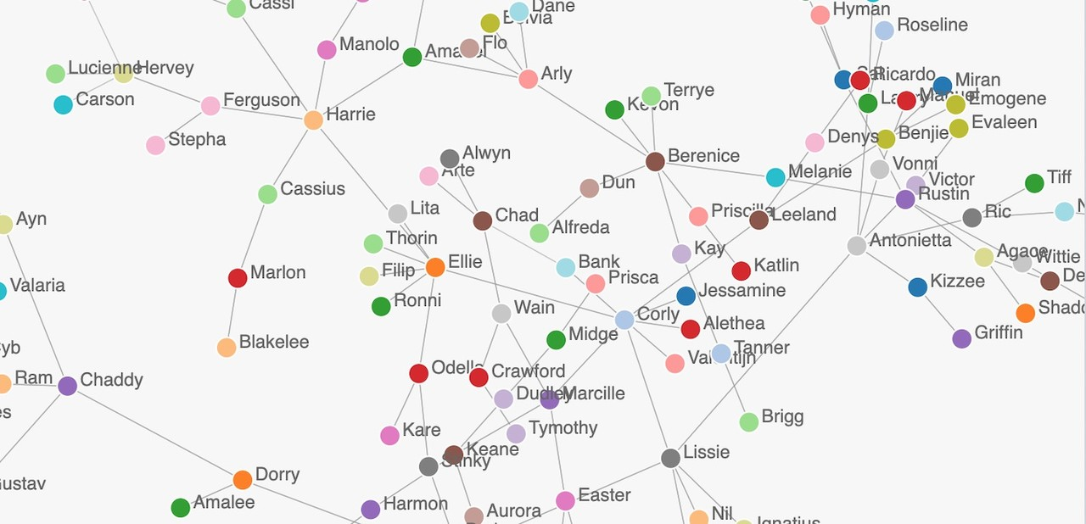
Definitions
A graph G = (V,E) consists of
A finite set of vertices V = {υ₁, υ₂, . . . , υ_{n}}
A finite set E of edges E = {e₁, e₂, . . . , e_{m}}

Slide 4
Definitions
Directed Graphs (DiGraph) and Undirected Graphs
|V| and |E| representations

Slide 5
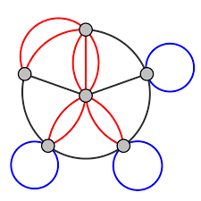
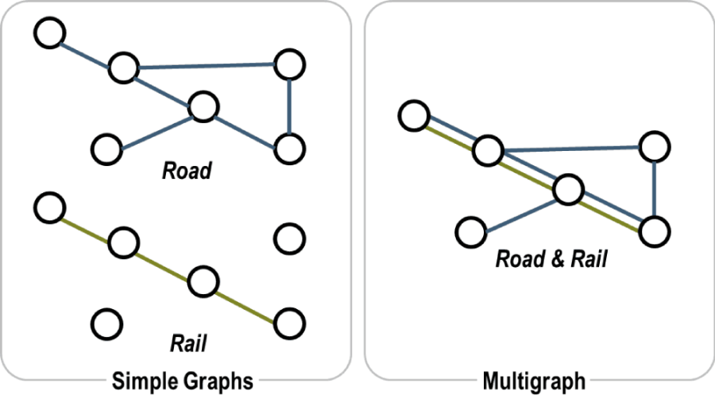
Definitions
Multigraph -> A graph with parallel edges/multi edges
Self Loop -> Same End vertices
Simple Graph -> No Loops or Parallel edges
General/Pseudo Graph -> includes Self loops and Parallel edges

Slide 6
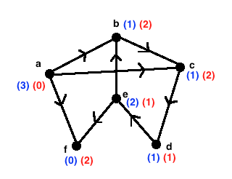
Definitions
In-degree and Out-degree
(x,y)-> x is predecessor and y is successor (digraph)

Slide 7
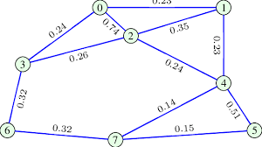
Definitions
weighted graphs / networks
Weight represent
the driving distance,
the construction cost,
the transit time,
the reliability,
the transition probability,
the carrying capacity, or any other such attribute of the edge

Slide 8
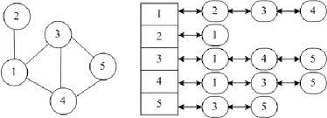
Graph Representations
Adjacency Lists:
The adjacency lists representation of a graph G consists of an array
Adj of n linked lists,
one for each vertex in G, such that Adj[υ] for vertex υ consists of all vertices adjacent to υ.
This list is often implemented as a linked list.

Slide 9
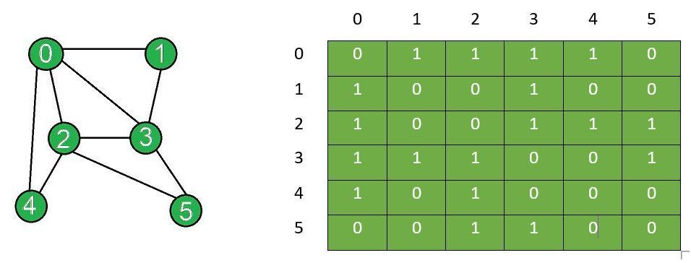
Graph Representations
Adjacency Matrix:
The adjacency matrix of a graph G = (V,E) is an n × n matrix
A = [aij] in which aij = 1 if there is an edge from vertex i to vertex j in G; otherwise aij = 0.
Note that in an adjacency matrix a self-loop can be represented by making the corresponding diagonal entry 1.

Slide 10
Graph Representations
The memory required to store a graph of n vertices in the form of adjacency matrix is O(n²),
whereas for storing it in the form of its adjacency lists is O(m + n).

Slide 11
Weighted Graph Representation

Slide 12
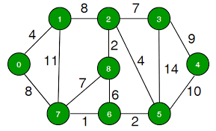
Connectivity, Distance, and Spanning Trees
A simple path, or path for short, is a sequence of adjacent edges (υ1, υ2), (υ2, υ3), . . ., (υk−2, υk−1), (υk−1, υk), sometimes written (υ1, υ2, . . . , υk), in which all the vertices υ1, υ2, . . . , υk are distinct except possibly υ1 = υk.
The number of edges in a path, in this case, k − 1, is called the length of the path.
A cycle or circuit is a path in which the first and the last vertices are the same.

Slide 13
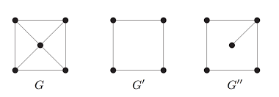
Connectivity, Distance, and Spanning Trees
A subgraph of a graph G = (V,E) is a graph whose vertices and edges are in G.
A subgraph g of G is said to be induced by a subset of vertices S ⊆ V if g results when the vertices in V − S and all the edges incident on them are removed from G.

Slide 14
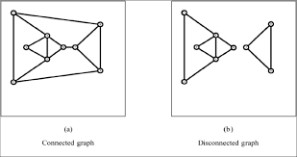
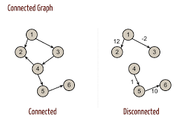
Connectivity, Distance, and Spanning Trees
An undirected graph G is said to be connected if there is at least one path between every pair of vertices υi and υj in G.
Graph G is said to be disconnected if it has at least one pair of distinct vertices u and v such that there is no path between u and v.

Slide 15
Connectivity, Distance, and Spanning Trees
A connected graph consists of just one component, whereas a disconnected graph consists of several (connected) components.

Slide 16
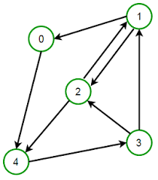
Connectivity, Distance, and Spanning Trees
A directed graph is said to be strongly connected if for every pair of vertices υi and υj there exists at least one directed path from υi to υj and at least one from υj to υi.
A digraph which is connected but not strongly connected is called weakly connected.
The distance from vertex a to b is the length of the shortest path (i.e., a path of the smallest length) from a to b, if such a path exists.
If no path from a to b exists, the distance is undefined and is often set to ∞.

Slide 17
Searching in a graph – 2 Types
Breadth-First Search
At a vertex v we scan all edges incident on v and then move to an adjacent vertex w, then from w we scan all edges incident on w.
This process is continued till all the edges reachable from v are scanned.
This method of fanning out from a given vertex v and visiting all vertices reachable from v in order of their distances from v (i.e. first visit all vertices at a distance one from v, then all vertices at distances two from v, and so on) is referred to as the breadth-first search (BFS) of the graph.
The Breadth First Search (BFS) is an algorithm for traversing or searching tree or graph data structures. It explores all the nodes at the present depth before moving on to the nodes at the next depth level.

Slide 18
BFS Applications
BFS can be used in web crawlers to create web page indexes.
BFS can be used to find the neighboring locations from a given source location.
In a peer-to-peer network, BFS algorithm can be used as a traversal method to find all the neighboring nodes.
Time complexity of BFS depends upon the data structure used to represent the graph. The time complexity of BFS algorithm is O(V+E), since in the worst case, BFS algorithm explores every node and edge. In a graph, the number of vertices is O(V), whereas the number of edges is O(E).
BFS can traverse through a graph in the smallest number of iterations.
There is no possibility of this algorithm getting caught up in an infinite loop problem.

Slide 19
BFS Algorithm

Slide 20
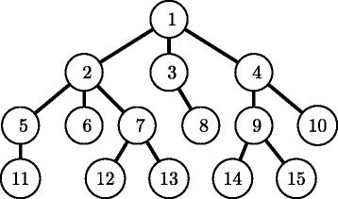
Illustration of BFS

Slide 21
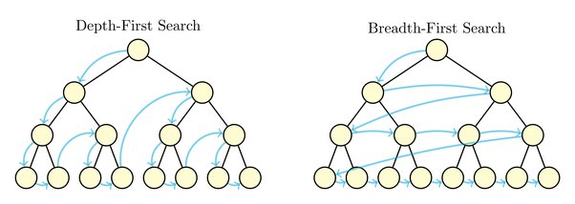
BFS

Slide 22
DFS (Depth First Search)
Step 1: Create a stack with the total number of vertices in the graph as the size.
Step 2: Choose any vertex as the traversal's beginning point. Push a visit to that vertex and add it to the stack.
Step 3 - Push any non-visited adjacent vertices of a vertex at the top of the stack to the top of the stack.
Step 4 - Repeat steps 3 and 4 until there are no more vertices to visit from the vertex at the top of the stack.
Step 5 - If there are no new vertices to visit, go back and pop one from the stack using backtracking.
Step 6 - Continue using steps 3, 4, and 5 until the stack is empty.

Slide 23
DFS

